Slide 1
Analyses of qualitative data
GRASSMATE seminar
19. September 2002
Stein Dankert Kolstø

Slide 2
Main ideas to be dealt with
1. Theory guides analyses
2. Important to focus
3. Coding starts with “topicalisation”
4. Coding and interpretation proceeds with reading “behind the lines”

Slide 3
All analysis involves theory!
Because your prior ideas guides your eyes
Because “pure observations”, neutral and objective, not guided by your “prejustice”, is not possible according to constructivistic epistemologies

Slide 4
Quantitative inquiry
Theory guides the development of instruments
If not: theory is still embedded in the instrument
  An analysis of the instruments might reveal the underlying theory
Knowledge of the instrument’s theory-base is necessary to interpret findings in adequate terms

Slide 5
Qualitative inquiry
Theory guides the foci for the study
Theory guides the research questions
Theory guides the collection of data
Theory guides the analysis of data

Slide 6
What is theory then?
The ideas which guides your research
Concepts, network of concepts
Your own ‘personal’ theory
Your unconscious theory in the back of your head
Theory or concepts taken from the literature

Slide 7
My own ongoing inquiry
Research question:
  What criteria do students use when assessing information with a science dimension?
Data:
  Students’ written assessments of WebPages on socio-scientific issues
Theory
  1. Phenomenological analysis involving four main strategies
  2. Constructivist view of production of scientific knowledge

Slide 8
Elaos’ project
Research question
  Is there a relationship between an A level Chemistry teacher’s epistemological beliefs and the type of laboratory instruction employed by the teacher?
Data:
  Classroom observations, questionnaires and interviews with teachers
Theory which will guide his analysis:
  Theories about the nature of science
  Theory (definitions) about school science practical work

Slide 9
The 1000-pages question
”How can I find a method to analyse the 1,000 pages of interviews transcripts I have collected?
”Have” - The question is posed to late
”1,000 pages” - Too much!
”How” - Ask ”What is the goal” first
  Interpretation rests on clarification of topic and purpose of the interview
  Kvale, Steinar (1996): InterViews. London: SagePublications

Slide 10
Analysis of data
Important to focus ?
  Wrong question!
  Open or narrow-minded?
When to focus in?
  Right question!

Slide 11
Focusing in
1. Foci emerges from your research questions
2. Foci emerges from inspection of data
  Using data to help choosing between different possible foci
  Using data to discover possible foci (within your theoretical perspectives)

Slide 12
Weak foci gives lots of diverging ”findings”
Time consuming
Diverging issues dealt with at the outset of the analysis
Codes and findings used in the report
Final focus

Slide 13
Analyses of data
“…the process is highly intuitive”
      (Merriam 1998 p.156)
Three main stages:
0. Unavoidable and important analysis during data collection
  Prior to the more structured phases of the analysis?

Slide 14
Analyses of data
“…the process is highly intuitive” (Merriam 1998 p.156)
Three main stages:
0. Unavoidable and important analysis during data collection
1. Stage in coding the data
  “Topicalisation”

Slide 15
Analyses of data
“…the process is highly intuitive” (Merriam 1998 p.156)
Three main stages:
0. Unavoidable and important analysis during data collection
1. Stage in coding the data
2. Stage in coding the data
  “Reading behind the lines’: “What’s going on here?”

Slide 16
0: Analysis during data collection
Write it down!
Let analysis of current data guide analyses of further data collection?

Slide 17
Analysis: Coding stage 1
Topicalisation: The identification of topics
Research in the super marked
  How to sort 2000 food items in a grocery store?
  What perspective to choose? Price, weight, colour, ...
  Compare and look for similarities and differences
  What labels (categories) to choose?
      Merriam, S. B. (1998): Qualitative research and case study applications in education. London: Sage. P. 180.
  Memos: Write down tentative definitions and ideas!

Slide 18
Analysis: Coding stage 2
Reading “behind the lines”
Reading “across the data”
Memos: Write down tentative definitions and ideas!

Slide 19
My doctoral thesis
Research question:
  How do students argue in relation to a socio-scientific issue?
Method
  Qualitative data and inductive analysis
Data:
  Interviews with 22 students, 16 years old

Slide 20
My doctoral thesis: Coding stage 1
Focus: What arguments do the students use?
Coding:
  Identification of statements that somehow relates to students use of knowledge in his/her thinking
  Topicalisation:
    View of the risk and risk estimates
    Arguments or information emphasised
    Personal decision
Result:
  Occurrences of different views and emphasisis
  Data matrix

Slide 21
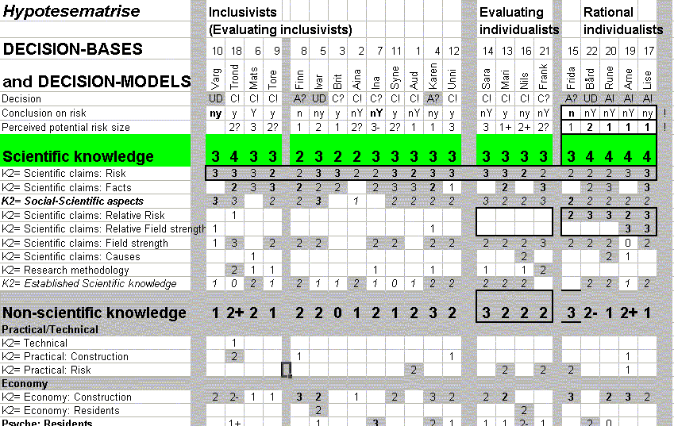
My data matrix (1)

Slide 22
My doctoral thesis: Coding stage 2
Question / focus:
  How do the students use these arguments to arrive at a decision
Strategy
  Data-matrix with arguments and students: looking for patterns
  Discovered that values and views of the possible risk was important in the students’ evaluations
  Coding stage 1 regarding view of the possible risk involved
  New manipulation of data-matrix and inspection of selected interviews

Slide 23
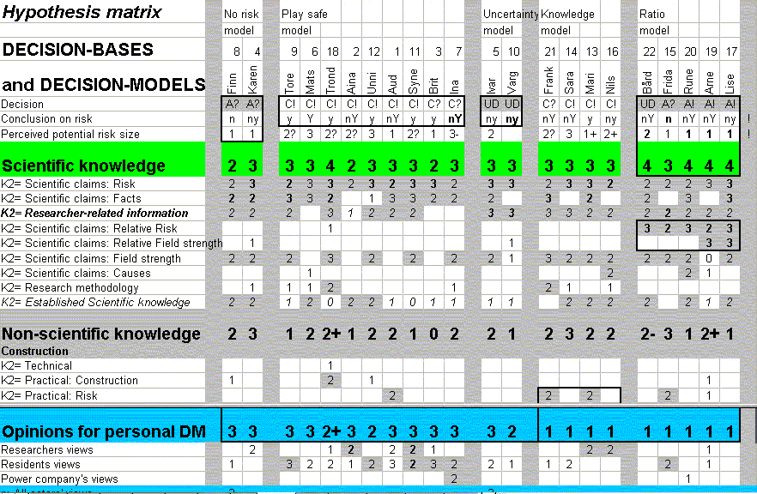
My data matrix (2)

Slide 24
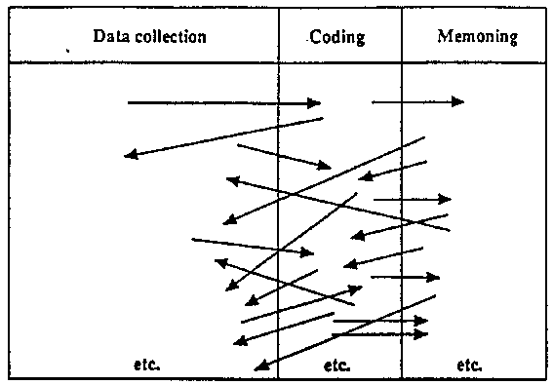
“The constant comparative method”
Code - and retrieve!
Look for similarities and differences!
    Strauss, A. (1987): Qualitative analysis for social scientists. Cambridge: Cambridge University Press, p. 19.

Slide 25
My resulting theory about the students’ decision-making
Discovered reoccurring decision-making patterns
  Decision guided by view of the small possible risk
  A decisive value
  On or two decisive arguments or facts

Slide 26
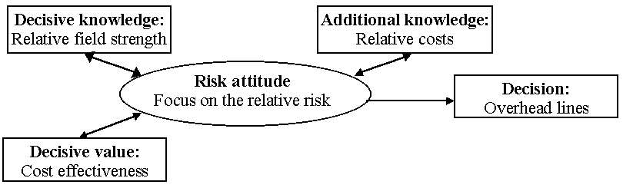
The relative risk model
Example of one of the four patterns identified:

Slide 27
Constructing theory
Analysis ’between the lines’ might result in a theory about the phenomena studied
”What is really going on here?”
  Conceptualising relationships between categories implies theory-building
  moving up “from empirical trenches to a more conceptual overview of the landscape. We’re no longer just dealing with observables, but also with unobservables, and are connecting the two with successive layers of inferential glue”
      Miles and Huberman (1994): Qualitative data analysis: an expanded sourcebook. Thousand Oaks, California: Sage. p.261

Slide 28
Display your theory or conceptual framework for your readers
Your findings are related to your perspective / conceptual framework
Judgements of the trustworthiness and credibility of your findings need to be based on awareness of the conceptual framwork used in the study.
Analysis from other perspectives might result in different findings, without implying an invalidation of your findings

Slide 29
These slides, and my chapter on methodology in my doctoral dissertation, are to be found at my website at
www.uib.no/people/pprsk/Dankert/index.htm

